Slide 1



Secure Big Data Processing
with Apache Spark + SGX
Imperial College London
LSDS resarch group
Christian Priebe, Luke Granger-Brown, Dan O’Keeffe,Pierre-Louis Aublin,
Florian Kelbert, Josh Lind, Divya Muthukumaran, Peter Pietzuch

Slide 2
Motivation (I)
SecureCloud
  Secure Big Data Processing in Untrusted Clouds
Apache Spark
  Cluster-computing framework
  Data parallelism and fault tolerance
  Addresses limitations of MapReduce

Slide 3
Motivation (II)
Problem: Spark does not protect data
  Data may be modified or leaked
  E.g., Spark may write data to disk
Goal: Data confidentiality and integrity
Approach: Run Apache Spark tasks using SGX

Slide 4
Apache Spark
Provides API on the basis of RDD (resilient distributed dataset) data structure
  RDD = collection of objects
    Split up and transformed on different nodes in parallel
  Example transformations
    filter, map, union, intersection
  Example actions
    count, first, take
Transformation
Action
RDD
RDD
RDD
RDD
Result

Slide 5
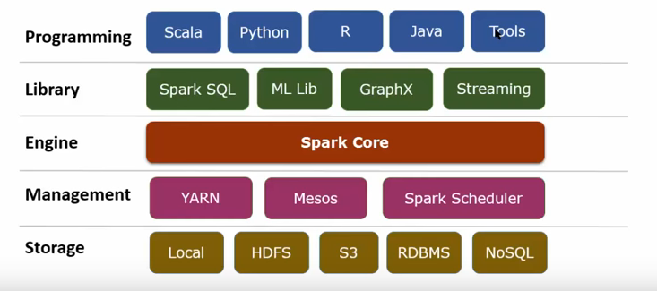
Apache Spark
Taken from https://www.youtube.com/watch?v=ZTFGwQaXJm8
Do not use in external presentations

Slide 6
Apache Spark System Model
Task 1
Task n
Spark
Spark
Spark
Spark
Task1
Taskn
Task1
Taskn
Task1
Taskn
Task1
Taskn
Task1
...
Taskn
Task1
Taskn
Task1
Taskn
Task1
Taskn
...
...
...
...
...
...
...
Spark
Spark
Spark
Spark
JVM
JVM
JVM
JVM
JVM
JVM
JVM
JVM
OS
OS
TEE
OS
OS
TEE
OS
OS
TEE
OS
OS
TEE





Slide 7

Our Idea
Protect task execution using SGX
  Integrity and confidentiality of tasks and input/output data
→ Run (parts of) Spark/JVM inside SGX TEE
Spark
Spark
Task1
Taskn
Spark
Man-
agement
Spark
Taskn
Task1
...
Taskn
Task1
Taskn
Spark
or
JVM
JVM
JVM
JVM
OS
OS
TEE
TEE
OS
OS
TEE
TEE

Slide 8
Our Idea
Task 1
Task n
Spark
Spark
Man-
agement
Spark
Spark
Spark
Man-
agement
Spark
Spark
Taskn
Taskn
Spark
Man-
agement
Spark
Task1
Task1
Taskn
Task1
Taskn
Taskn
Taskn
JVM
JVM
JVM
JVM
JVM
JVM
OS
OS
TEE
TEE
OS
OS
TEE
TEE
OS
OS
TEE
TEE




Slide 9
Our Solution
Use of LKL and musl
  LKL (Linux Kernel Library) Kernel code compiled into linkable library
  musl: libc implementation
Port LKL and musl to SGX
Link JVM against LKL/musl
Run JVM/LKL/musl within SGX
Load Spark code and tasks into the SGX-protected JVM
Spark
Man-
agement
Spark
Task1
Taskn
Spark
JVM
JVM
JVM
musl
LKL
OS
TEE
Host OS
SGX

Slide 10
Current Status
# MUSL_TAP=tap0 MUSL_HD=${PWD}/miniroot/alpine-rootfs.img MUSL_KERNEL=0 MUSL_VERSION=1 MUSL_ESLEEP=1 MUSL_SSLEEP=4000 MUSL_ESPINS=50000 MUSL_SSPINS=500 MUSL_STHREADS=32 MUSL_ETHREADS=4 obj/sgx-lkl-starter /usr/bin/java -XX:InitialCodeCacheSize=2000k -XX:ReservedCodeCacheSize=2000K -Xms8000k -Xmx8000k -XX:MaxPermSize=4000k -XX:CompileThreshold=2000 -XX:+PrintCompilation -Xss228k -classpath /home HelloWorld
MUSL_ETHREADS: 4
MUSL_STHREADS: 32
MUSL_SLOTS: 256
MUSL_SIGPIPE: 0
MUSL_MMAP32BIT: 0
MUSL_RTPRIO: 0
MUSL_ESPINS: 50000
MUSL_ESLEEP: 1
MUSL_SSPINS: 500
MUSL_SSLEEP: 4000
MUSL_KERNEL: 0
MUSL_HEAP: 83591168
Musl build parameters:
1.1.15Maximum enclave threads (TCS): 8
OpenJDK 64-Bit Server VM warning: Can't detect initial thread stack location - find_vma failed
202 1 % java.lang.String::hashCode @ 24 (55 bytes)
204 2 java.lang.String::indexOf (70 bytes)
221 3 java.lang.String::hashCode (55 bytes)
Hello world.

Slide 11
Open Challenges / Ideas
Limited EPC size
  Deactivate parts of JVM
  Support only some features of Spark
  Execute only parts of JVM/Spark inside SGX
Security considerations
  Communication between nodes
  Confidentiality/integrity of data
  Secure task/data provisioning

